Slide 1

Zomato order & restaurant analysis using Power BI

Slide 2
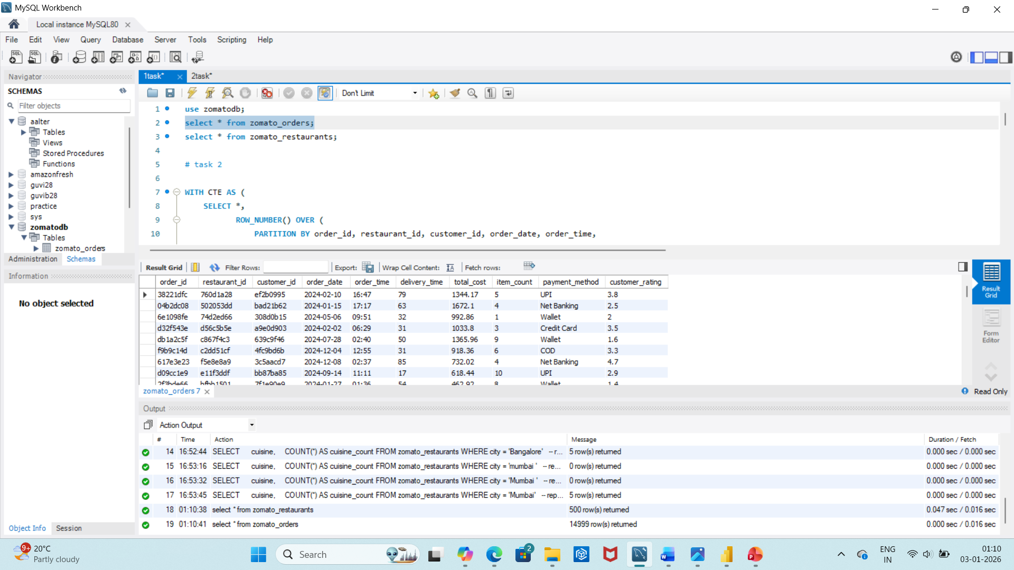
Sql tasks Task1
Uploaded The datasets into Mysql.

Slide 3
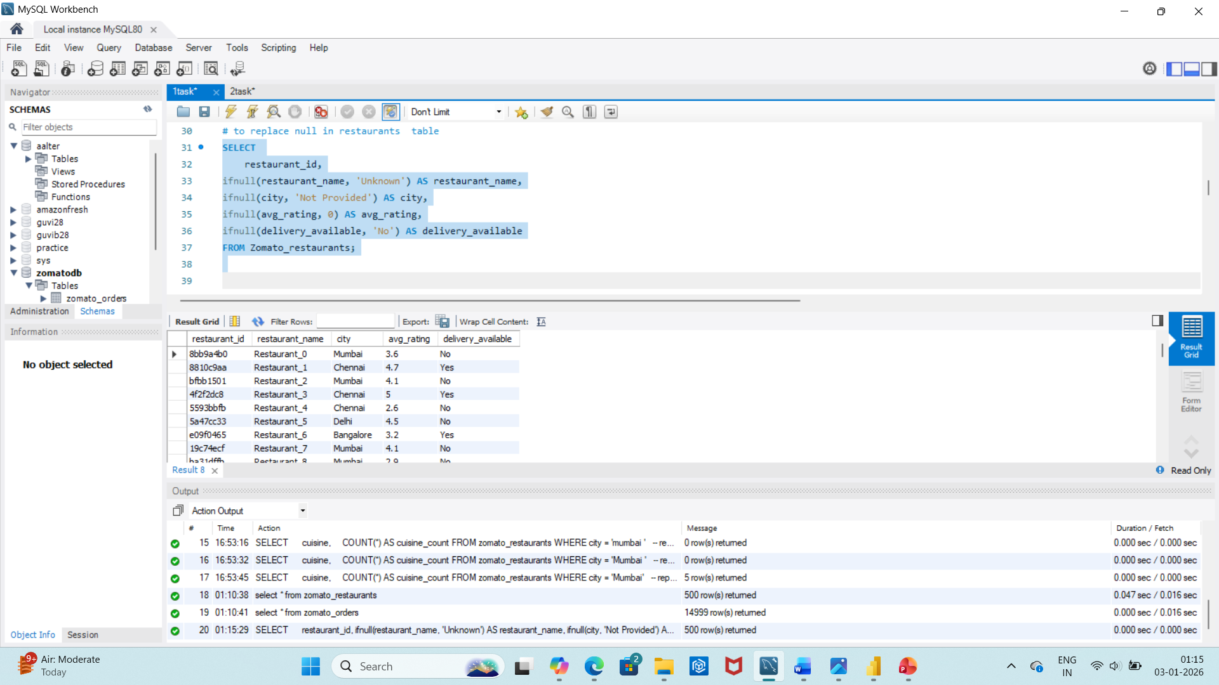
Task2
Basic Data Cleaning Done To
Remove duplicate records.
Handle NULL values (if any) by replacing them with appropriate values.

Slide 4
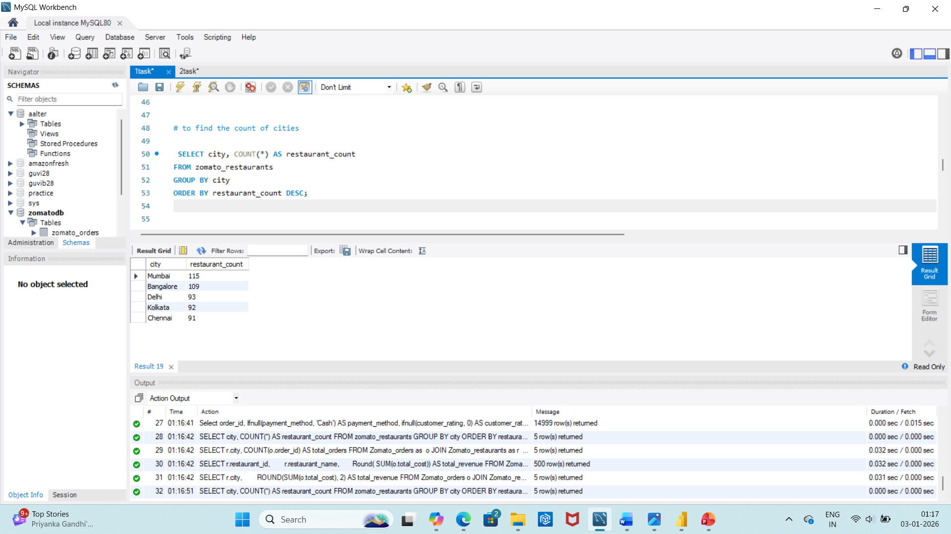
To Count the number of restaurants in each city.

Slide 5
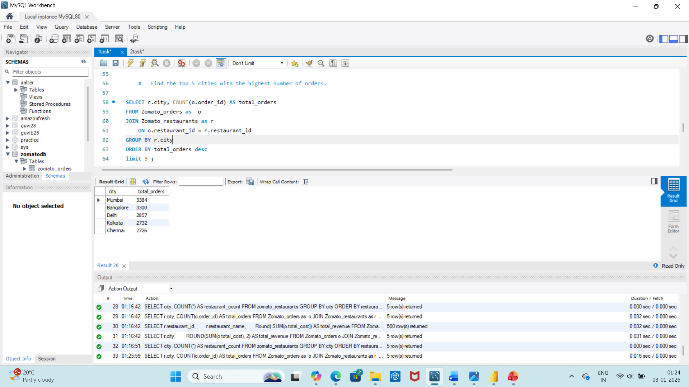
Finding the top 5 cities with the highest number of orders.

Slide 6
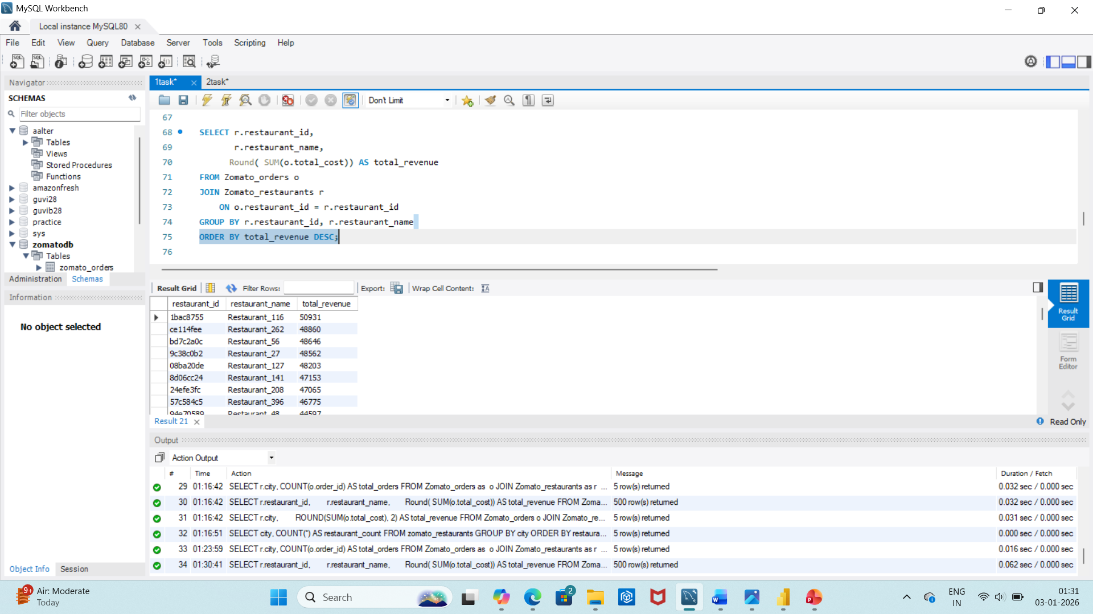
Total revenue generated by each restaurant.

Slide 7
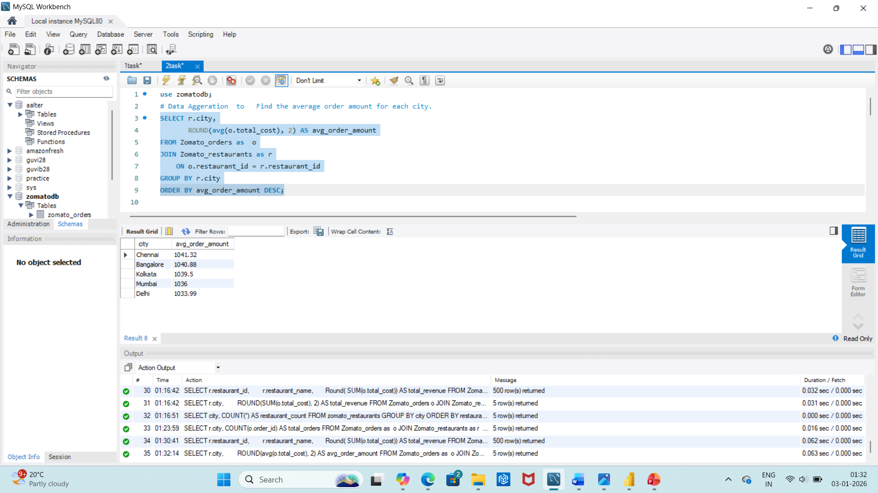
○ Find the average order amount for each city.

Slide 8
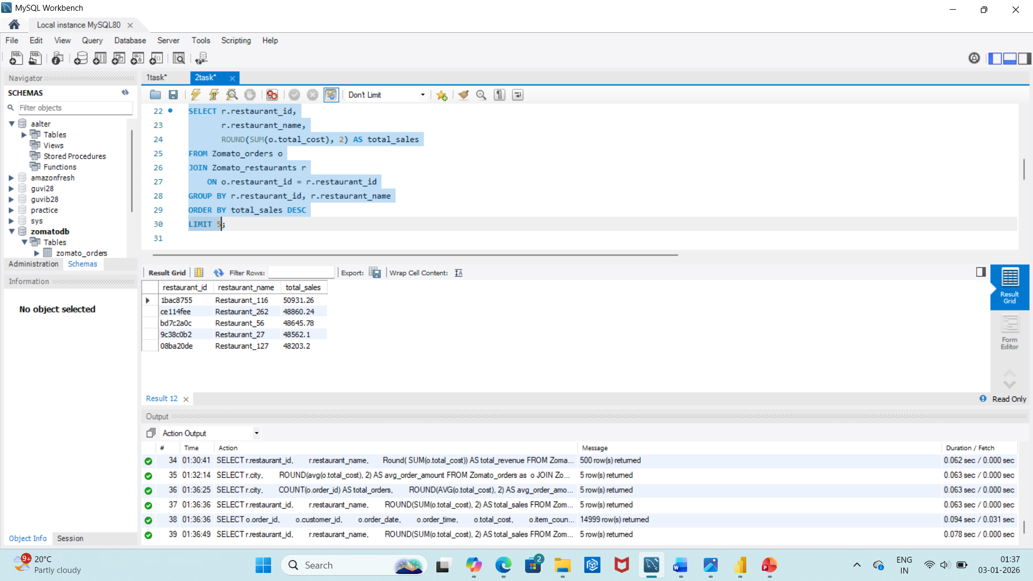
the top 5 restaurants with the highest total sales.

Slide 9
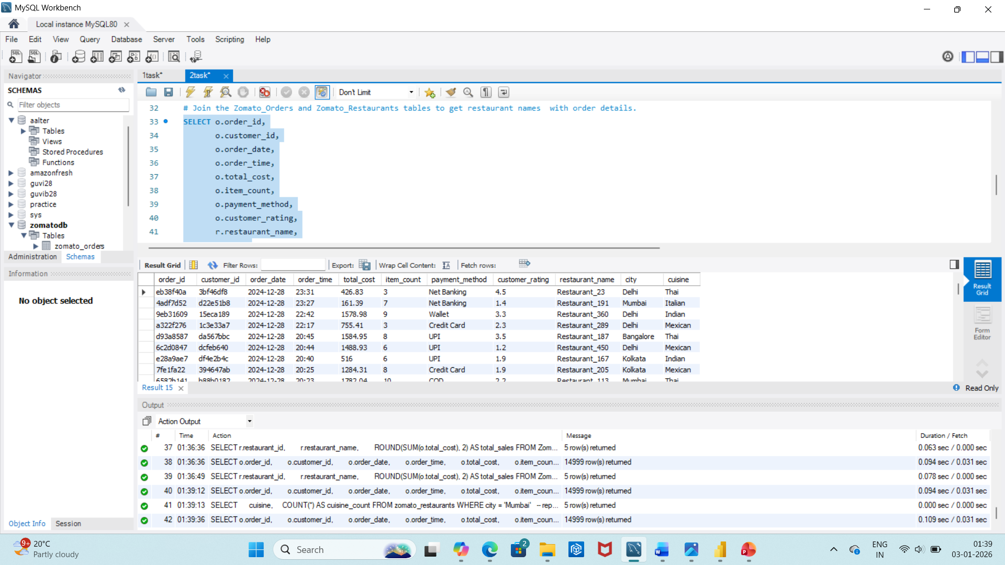
Join the Zomato_Orders and Zomato_Restaurants

Slide 10
Then transformed the data into the Excel file after data cleaning and using it in the power Bi .
Diving into the power Bi tasks .

Slide 11
Task 1
Mumbai, with the highest number of restaurants, shows Thai cuisine leading in sales and supply, effectively meeting the city’s food demand.
Chennai, with the lowest number of restaurants, shows Mexican cuisine leading in sales and supply, effectively meeting the city’s food demand.
Bangalore , with the second highest number of restaurants, shows Mexican cuisine leading in sales and supply, effectively meeting the city’s food demand.
In Delhi and Kolkata cities the Italian cuisine leading in sales but supply does not effectively meet the city’s food demand.

Slide 12
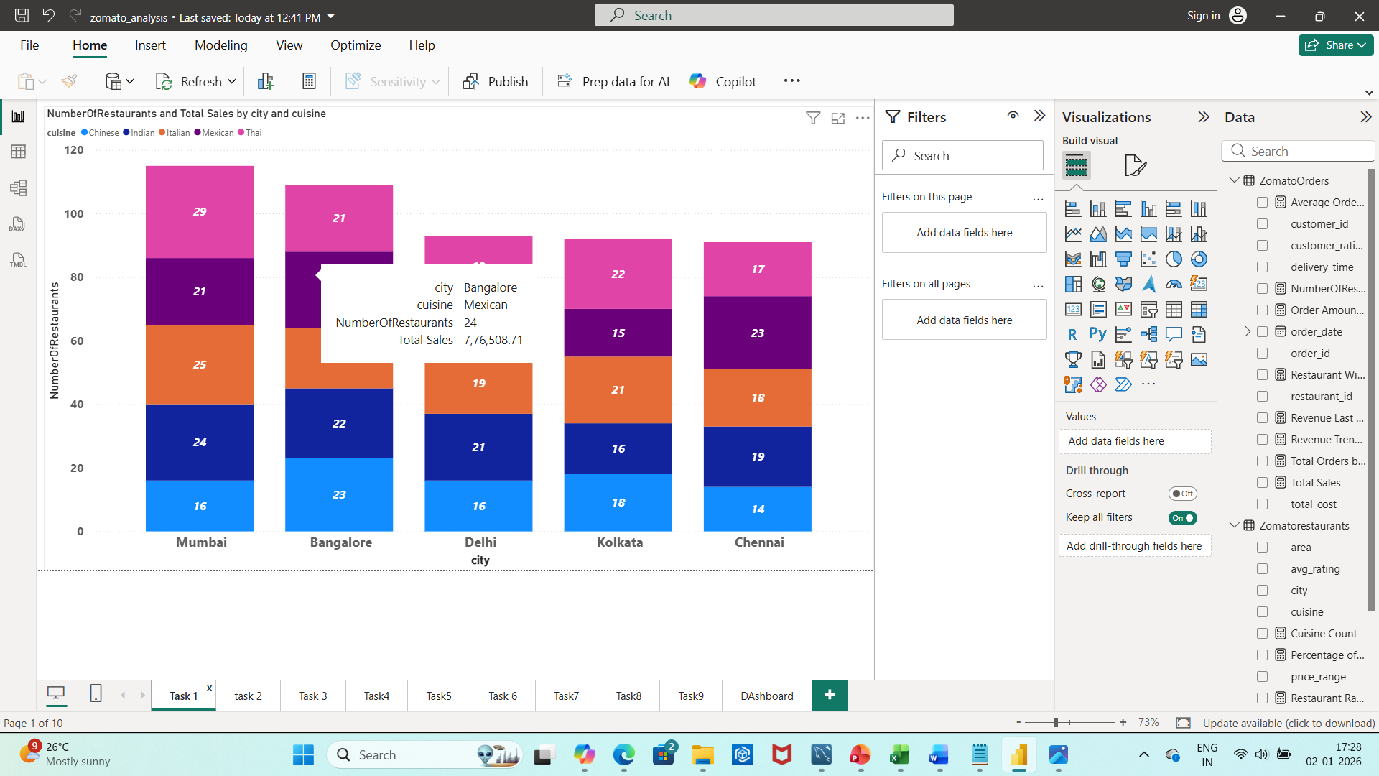

Slide 13
Task 2
By looking at the pie chart we get the following details
The total number of orders received are 15,000 across all the cities.
Mumbai in the 1st place has the highest number of orders with 3384 contributing 22% of the total orders. Thus dominating the Zomato market.
Mumbai is in the last place in terms of lowest orders per restaurant (29.4) indicating lower utilization per outlet .
Chennai has the lowest number of orders with 2727 contributing 18% of the total orders.
Bangalore in the 2^{nd place} having 3300 orders contributing 22% of the total orders
Delhi in the 3rd place having 2857 orders contributing 19 % of the total orders but has the highest orders per restaurant (30.7), indicating strong demand relative to supply.
Kolkata in the 4th place having 2732 orders contributing 18 % of the total orders.

Slide 14
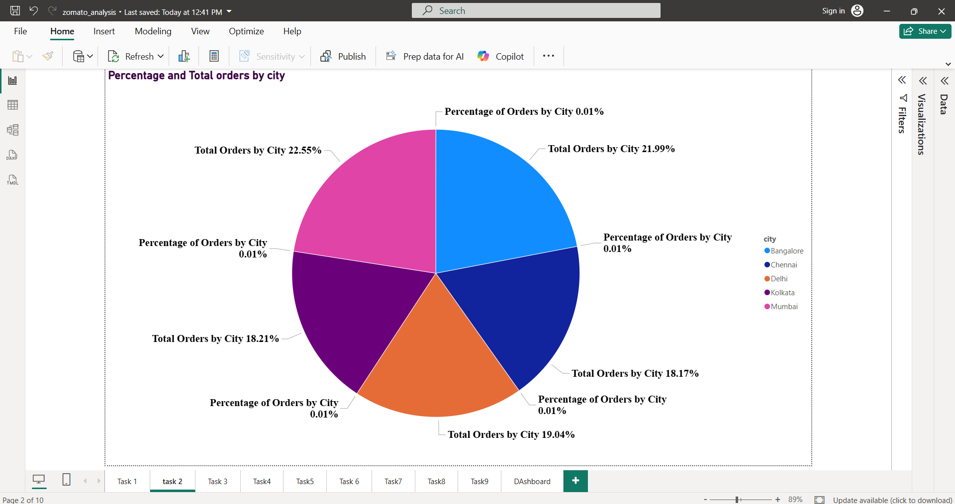

Slide 15
Task 3
Analysing peak sales periods and slow periods by each city.
city | Maximum order on Date With amount | Minimum order on Date With amount | Maximum orders month | Minimum orders month
Chennai | May 10, Rs22,546.39 | Nov 12 Rs 200.76 | April | July
Delhi | July 17 Rs21,013.92 | May 15 Rs 1,368.48 | October | December
Bangalore | May 3 Rs 26,048 | November 8 Rs 1,745.84 | July | June
Kolkata | Jan 20 Rs 20,066.22 | July 22 Rs 451.88 | August | November
Mumbai | December 20 Rs 21,617.69 | January 13 Rs 2,596.43 | October | January

Slide 16
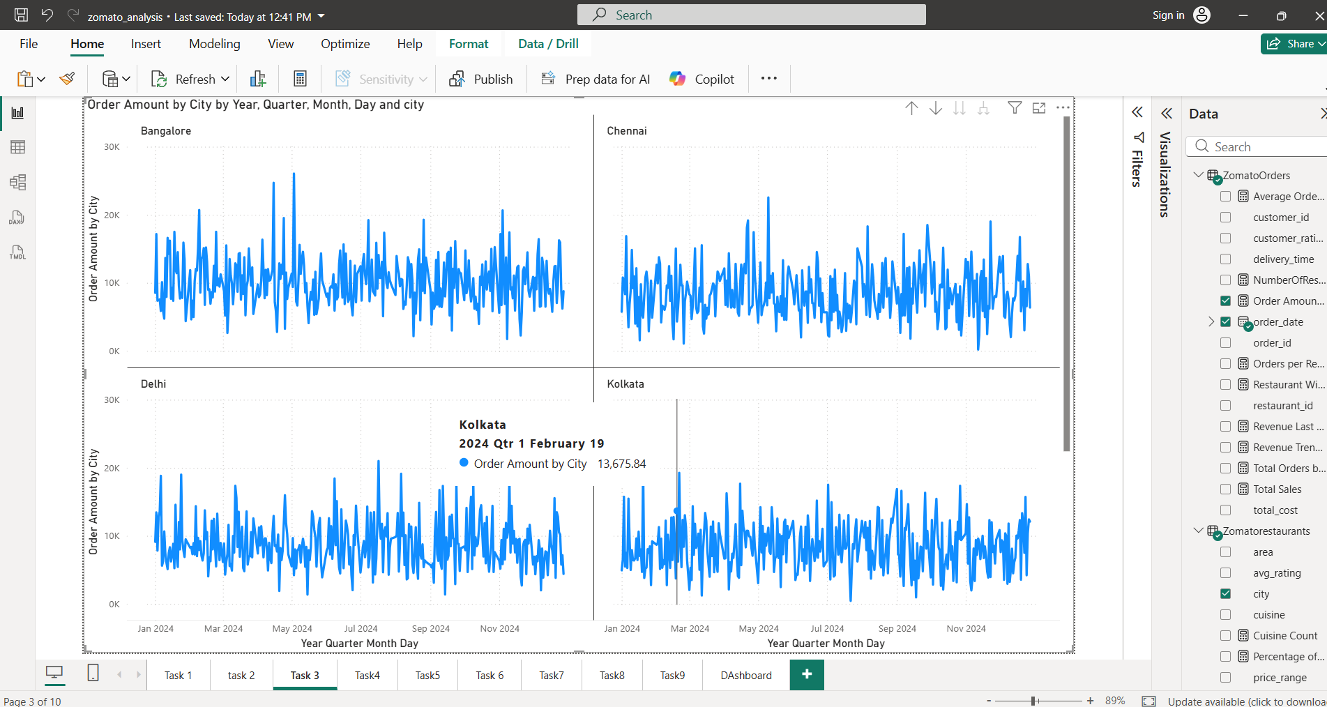
There are higher orders during holidays in May in cities Bangalore and Chennai.
During Diwali season October there are great sales in Kolkata, Delhi and Mumbai.
In January Delhi and Kolkata have high orders.
Overall there is balance in orders in October month.

Slide 17
Task 4
Identifying correlations between different factors using a scatter plot.
Only in a few cases the delivery time effects the customer ratings overall its stable.
Shorter delivery time give more customer satisfaction but viewing overall its stable.
Overall analysis tells us that the order count , price and delivery time does not effect the customer ratings its stable.

Slide 18
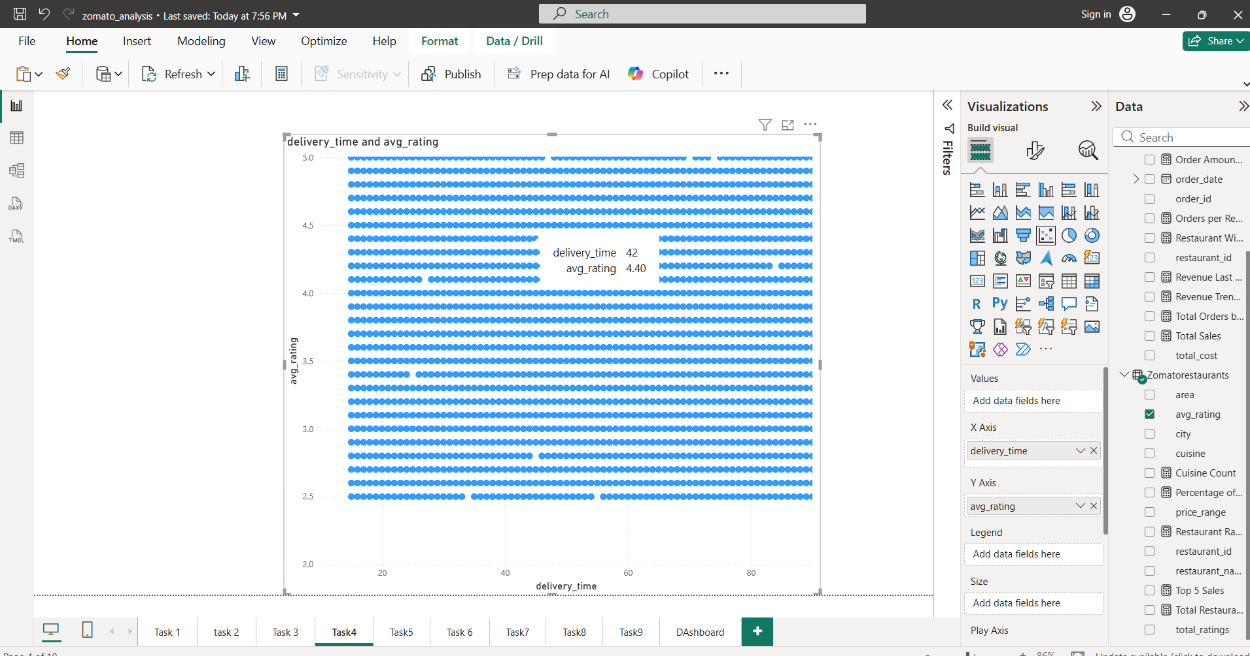

Slide 19
Task 5
Identifying the Top 5 Restaurants by Total Sales
The top 5 restaurants are
1) Restaurants_116 in Bangalore which is an Indian cuisine with low price range having average rating of 4.8 .
2) Restaurants_262 in Bangalore which is Mexican cuisine with medium price having average rating of 2.5 .
3) Restaurants_56 in Mumbai which is a Thai cuisine with low price range having average rating of 4.6 .
4) Restaurants_27 in Delhi which is a Italian cuisine with high price range having average rating of 2.6 .
5) Restaurants_127 in Bangalore which is a Indain cuisine with high price range having average rating of 4.4 .

Slide 20
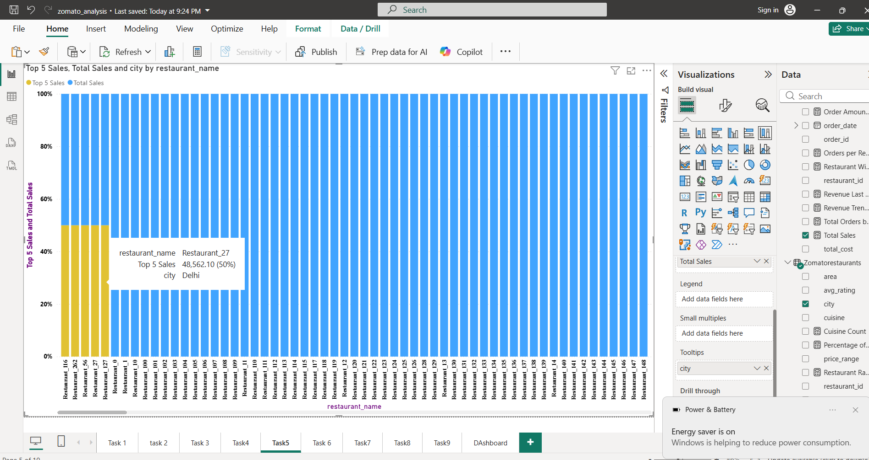

Slide 21
Task 6
Identifying Revenue by Area Using a Tree Map
Created a Tree map showing revenue area wise.
The top areas revenue wise are
1) Area_A
2) Area_B
3) Area_D
4) Area_C
5) Area_E
The revenue is driven by a high number of orders.

Slide 22
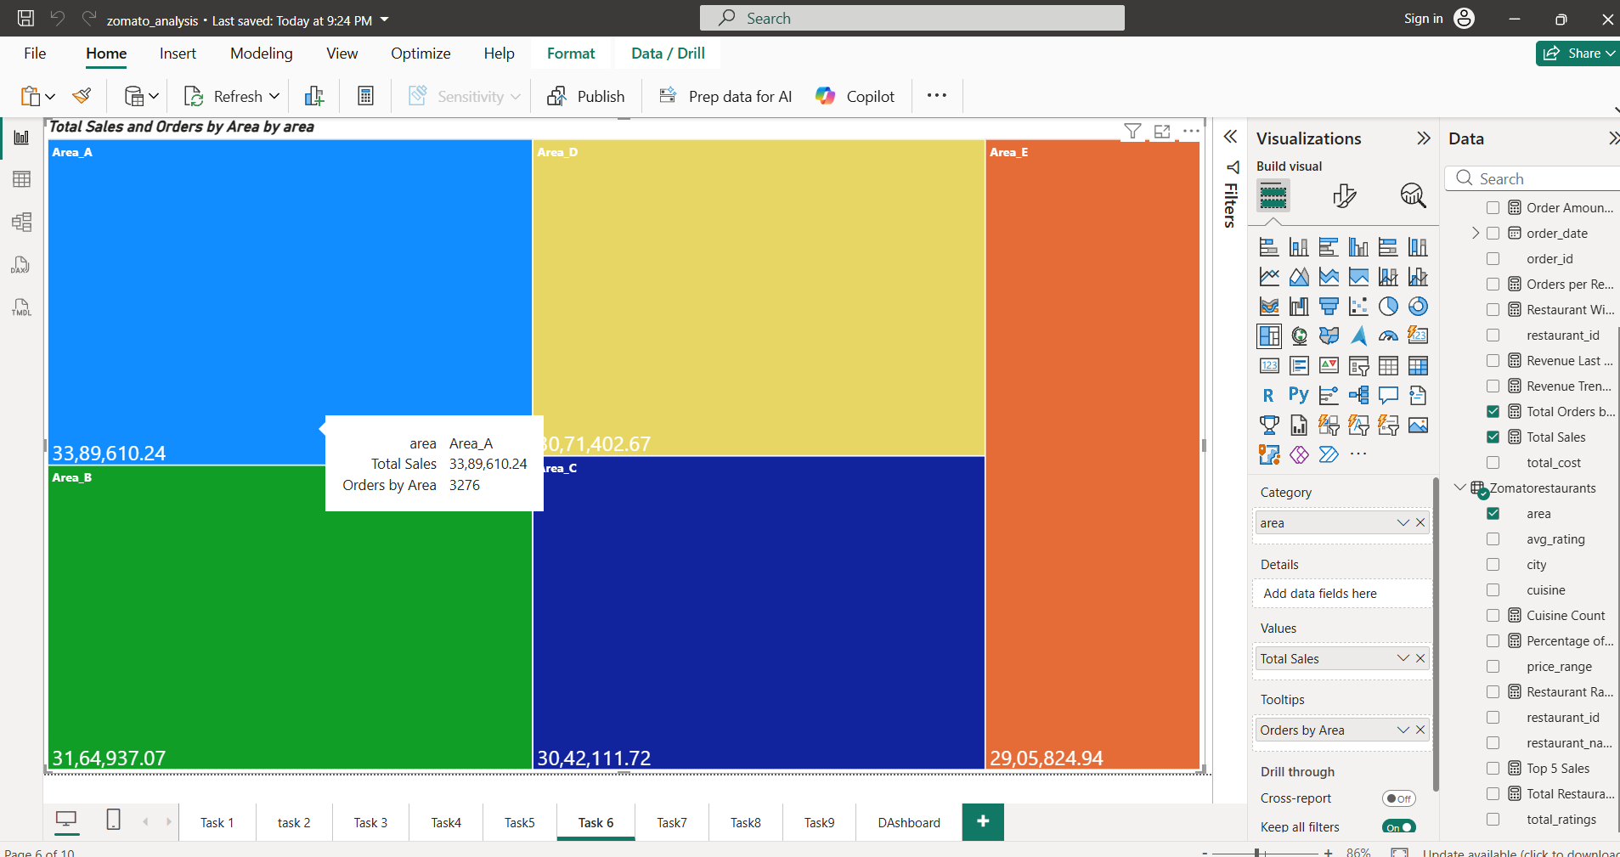

Slide 23
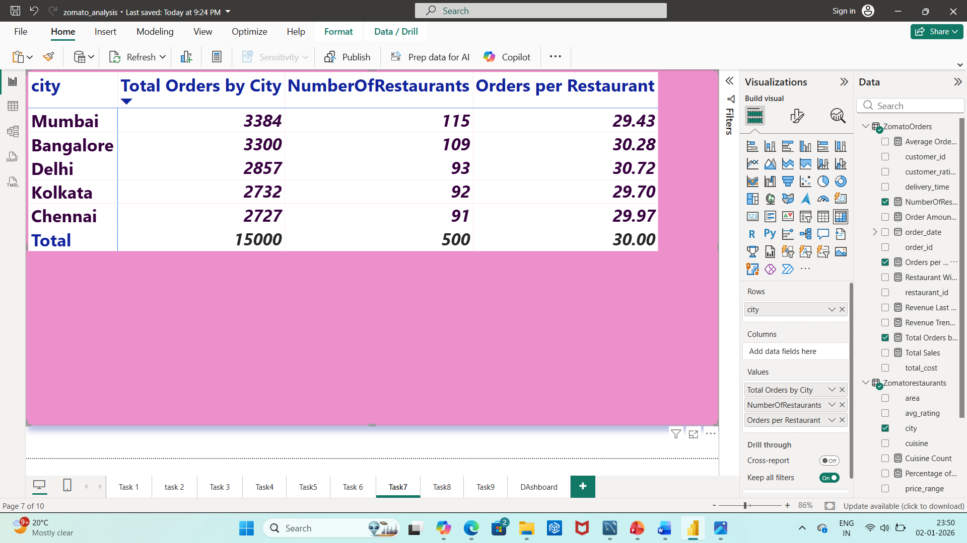
Task 7
Identifying Order Density by City Using a Heat Map

Slide 24
Mumbai has the highest orders but the supply is more where there is no demand.
Delhi has more demand but does not meet its requirements.
Bangalore, Kolkata and Chennai are stable where supply satisfies the customer’s demands.
Overall Mumbai has slightly lower utilization per outlet, possibly due to oversupply or uneven distribution.
whereas Delhi has High demand but limited supply.

Slide 25
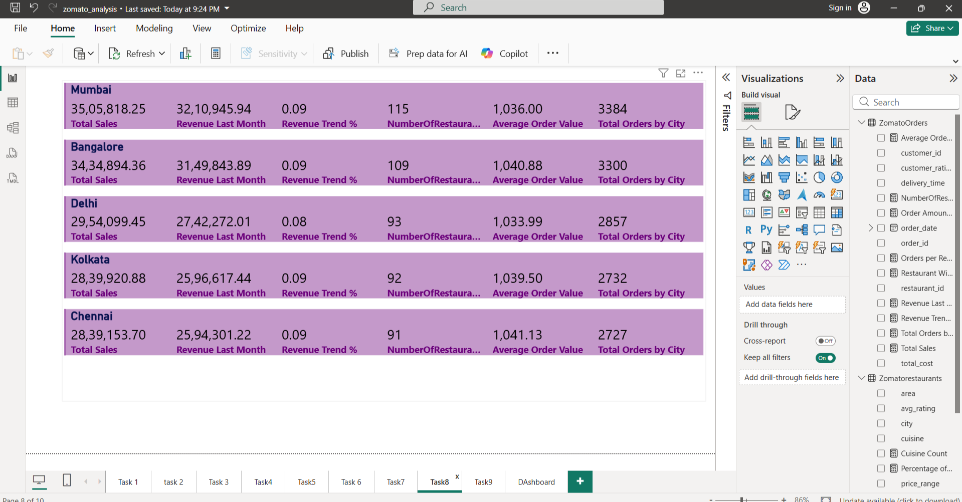
Task 8
Displaying key business performance metrics

Slide 26
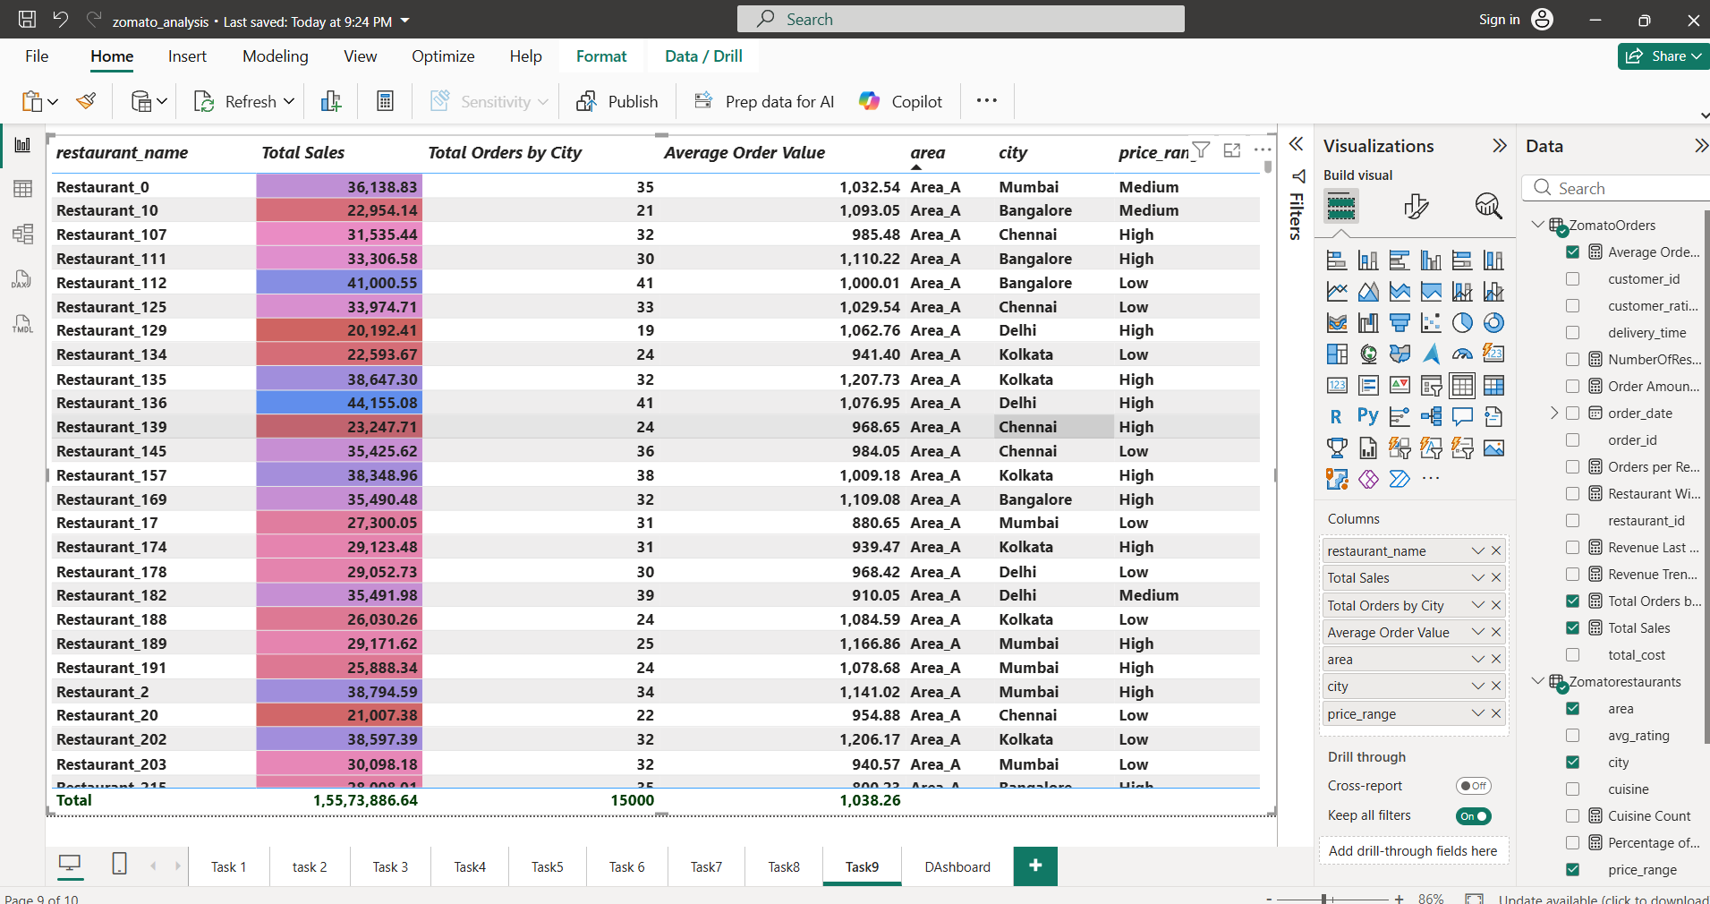
Task 9
Created a structured table summarizing restaurant-wise sales performance
Applied sorting and conditional formatting to key features required.
Enabled filters to fields wherever required.

Slide 27
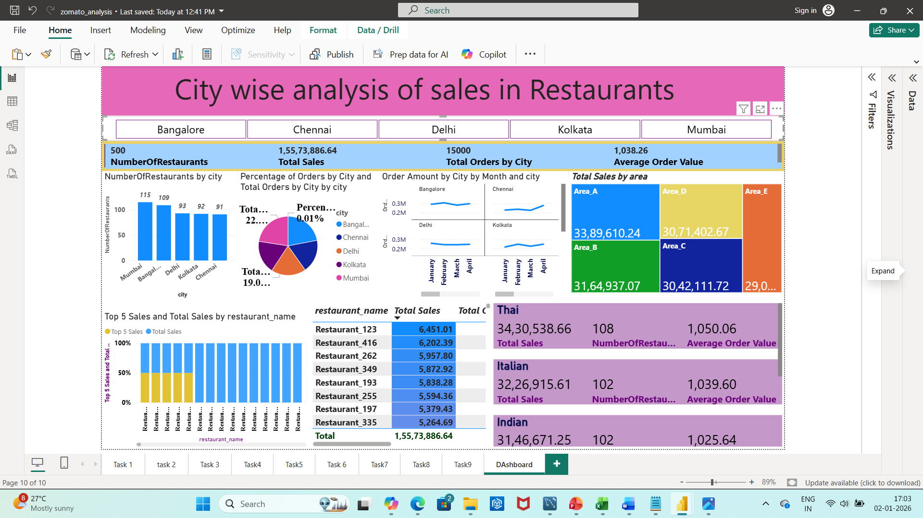
Task 10
Created a fully interactive dashboard combining all previous visualizations for a complete business overview.

Slide 28
Business Insights
Mumbai Leads in both revenue and orders volume but has oversupply, lower utilization per outlet.
Delhi has highest orders per restaurant (30.7).
Bangalore is the best performer having 3/5 under the top 5 sales generating restaurants with a balance of supply to the customer demand .
Kolkata and Chennai(least revenue) needs to Maintain the supply and improvise and monitor the growth.

Slide 29
Top cuisines by city
Thai in Mumbai
Mexican in Chennai/Bangalore.
Italian in Delhi/ Kolkata.
There was High order density in Area A and Area B.

Slide 30
Recommendations
Mumbai must have targeted promotions to address oversupply and optimize the visibility.
Delhi has to scope to Expand restaurants and boost the sales to meet the unmet demand.
Highlighting Balanced growth in Bangalore ,as a model city for performance.
Seasonal Strategies (Diwali/ holidays) must be implemented to maximize sales.

